Slide 1
Lecture 2: Operations and Data Types
Copyright (c) Pearson 2013.
All rights reserved.

Slide 2
Data types
type: A category or set of data values.
  Constrains the operations that can be performed on data
  Many languages ask the programmer to specify types
  Examples: integer, real number, string
Internally, computers store everything as 1s and 0s
  104 → 01101000
  "hi" → 01101000110101
Notes:
ask them, how might the computer store "hi" using binary digits? (some kind of mapping; ASCII)

Slide 3
Java's primitive types
primitive types: 8 simple types for numbers, text, etc.
  Java also has object types, which we'll talk about later
  Name Description Examples
  int integers (up to 2³¹ - 1) 42, -3, 0, 926394
  double real numbers (up to 10³⁰⁸) 3.1, -0.25, 9.4e3
  boolean logical values true, false
  char single text characters 'a', 'X', '?', '\n’
  Why does Java distinguish integers vs. real numbers?
Notes:
We're basically going to manipulate letters and numbers.
We make the integer / real number distinction in English as well. We don't ask, "How many do you weigh?" or, "How much sisters do you have?"
Part of the int/double split is related to how a computer processor crunches numbers. A CPU does integer computations and a Floating Point Unit (FPU) does real number computations.
Why does Java separate int and double? Why not use one combined type called number?

Slide 4
Expressions
expression: A value or operation that computes a value.
  Examples: 1 + 4 * 5
  (7 + 2) * 6 / 3
  42
  The simplest expression is a literal value.
  A complex expression can use operators and parentheses.

Slide 5
Arithmetic operators
operator: Combines multiple values or expressions.
  + addition
  - subtraction (or negation)
  * multiplication
  / division
  % modulus (a.k.a. remainder)
As a program runs, its expressions are evaluated.
  1 + 1 evaluates to 2
  System.out.println(3 * 4); prints 12
    How would we print the text 3 * 4 ?

Slide 6
Integer division with /
When we divide integers, the quotient is also an integer.
  14 / 4 is 3, not 3.5
3 4 52
4 ) 14 10 ) 45 27 ) 1425
12 40 135
2 5 75
54
21
More examples:
  32 / 5 is 6
  84 / 10 is 8
  156 / 100 is 1
  Dividing by 0 causes an error when your program runs.

Slide 7
Integer remainder with %
The % operator computes the remainder from integer division.
  14 % 4 is 2
  218 % 5 is 3
  3 43
  4 ) 14 5 ) 218
  12 20
  2 18
  15
  3
Applications of % operator:
  Obtain last digit of a number: 230857 % 10 is 7
  Obtain last 4 digits: 658236489 % 10000 is 6489
  See whether a number is odd: 7 % 2 is 1, 42 % 2 is 0
What is the result?
45 % 6
2 % 2
8 % 20
11 % 0
Notes:
What is 8 % 20? It's 8, but students often say 0.

Slide 8
Precedence
precedence: Order in which operators are evaluated.
  Generally operators evaluate left-to-right.
  1 - 2 - 3 is (1 - 2) - 3 which is -4
  But * / % have a higher level of precedence than + -
  1 + 3 * 4 is 13
  6 + 8 / 2 * 3
  6 + 4 * 3
  6 + 12 is 18
  Parentheses can force a certain order of evaluation:
  (1 + 3) * 4 is 16
  Spacing does not affect order of evaluation
  1+3 * 4-2 is 11

Slide 9
Precedence examples
1 * 2 + 3 * 5 % 4
\_/
|
2 + 3 * 5 % 4
\_/
|
2 + 15 % 4
\___/
|
2 + 3
\________/
|
5
1 + 8 % 3 * 2 - 9
\_/
|
1 + 2 * 2 - 9
\___/
|
1 + 4 - 9
\______/
|
5 - 9
\_________/
|
-4
Notes:
Ask the students what 15 / 4 and 2 / 3 are, since the answers are non-obvious.

Slide 10
Precedence questions
What values result from the following expressions?
  9 / 5
  695 % 20
  7 + 6 * 5
  7 * 6 + 5
  248 % 100 / 5
  6 * 3 - 9 / 4
  (5 - 7) * 4
  6 + (18 % (17 - 12))
Notes:
(I don't usually go through these in lecture; I tell them they are extra problems they can work on later)
Answers:
1
15
37
47
9
16
-8
9

Slide 11
Real numbers (type double)
Examples: 6.022 , -42.0 , 2.143
  Placing .0 or . after an integer makes it a double.
The operators + - * / % () all still work with double.
  / produces an exact answer: 15.0 / 2.0 is 7.5
  Precedence is the same: () before * / % before + -
Notes:
Point out that it's odd for 42.0 to be considered a real number, but it is.

Slide 12
Real number example
2.0 * 2.4 + 2.25 * 4.0 / 2.0
\___/
|
4.8 + 2.25 * 4.0 / 2.0
\___/
|
4.8 + 9.0 / 2.0
\_____/
|
4.8 + 4.5
\____________/
|
9.3

Slide 13
Mixing types
When int and double are mixed, the result is a double.
  4.2 * 3 is 12.6
The conversion is per-operator, affecting only its operands.
  7 / 3 * 1.2 + 3 / 2
  \_/
  |
  2 * 1.2 + 3 / 2
  \___/
  |
  2.4 + 3 / 2
  \_/
  |
  2.4 + 1
  \________/
  |
  3.4
  3 / 2 is 1 above, not 1.5.
2.0 + 10 / 3 * 2.5 - 6 / 4
\___/
|
2.0 + 3 * 2.5 - 6 / 4
\_____/
|
2.0 + 7.5 - 6 / 4
\_/
|
2.0 + 7.5 - 1
\_________/
|
9.5 - 1
\______________/
|
8.5
Notes:
I don't usually go through the expression on the right; I just show it very quickly and move on.

Slide 14
String concatenation
string concatenation: Using + between a string and another value to make a longer string.
  "hello" + 42 is "hello42"
  1 + "abc" + 2 is "1abc2"
  "abc" + 1 + 2 is "abc12"
  1 + 2 + "abc" is "3abc"
  "abc" + 9 * 3 is "abc27"
  "1" + 1 is "11"
  4 - 1 + "abc" is "3abc"
Use + to print a string and an expression's value together.
  System.out.println("Grade: " + (95.1 + 71.9) / 2);
  Output: Grade: 83.5

Slide 15
Your First Program
Write a program from scratch. (NO COPY AND PASTE ALLOWED)
You will write two static methods in addition to the main() method. Your methods should be called printMath() and printCat().
In the printMath() method, use both println and print commands to print some math expressions and check the evaluated value at runtime. You must use each of the operators + - * / % () and have at least five expressions.
In the printCat() method, use both println and print commands to print some examples of String concatenation. You must use both numbers and letters in your concatenation. Print at least five concatenations.

Slide 16
Variables

Slide 17
Receipt example
What's bad about the following code?
  public class Receipt {
  public static void main(String[] args) {
  // Calculate total owed, assuming 8% tax / 15% tip
  System.out.println("Subtotal:");
  System.out.println(38 + 40 + 30);
  System.out.println("Tax:");
  System.out.println((38 + 40 + 30) * .08);
  System.out.println("Tip:");
  System.out.println((38 + 40 + 30) * .15);
  System.out.println("Total:");
  System.out.println(38 + 40 + 30 +
  (38 + 40 + 30) * .08 +
  (38 + 40 + 30) * .15);
  }
  }
  The subtotal expression (38 + 40 + 30) is repeated
  So many println statements

Slide 18

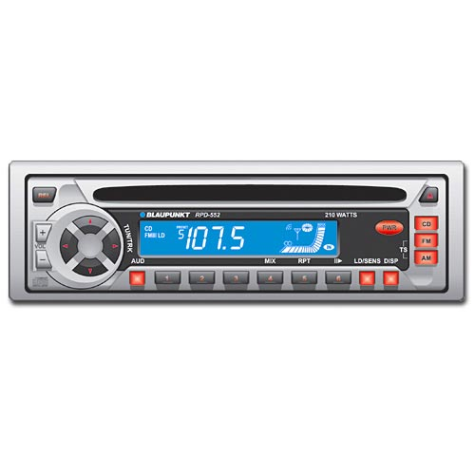
Variables
variable: A piece of the computer's memory that is given a name and type, and can store a value.
  Like preset stations on a car stereo, or cell phone speed dial:
  Steps for using a variable:
    Declare it - state its name and type
    Initialize it - store a value into it
    Use it - print it or use it as part of an expression
Notes:
a variable is also like the MS / MR buttons on a calculator
variables must be declared before they are used, just like methods

Slide 19
Declaration
variable declaration: Sets aside memory for storing a value.
  Variables must be declared before they can be used.
Syntax:
  type name;
    The name is an identifier.
  int x;
  double myGPA;
x
myGPA

Slide 20
Assignment
assignment: Stores a value into a variable.
  The value can be an expression; the variable stores its result.
Syntax:
  name = expression;
  int x;
  x = 3;
  double myGPA;
  myGPA = 1.0 + 2.25;
x | 3
myGPA | 3.25

Slide 21
Using variables
Once given a value, a variable can be used in expressions:
  int x;
  x = 3;
  System.out.println("x is " + x); // x is 3
  System.out.println(5 * x - 1); // 14
You can assign a value more than once:
  int x;
  x = 3;
  System.out.println(x + " here"); // 3 here
  x = 4 + 7;
  System.out.println("now x is " + x); // now x is 11
x | 3
x | 11

Slide 22
Declaration/initialization
A variable can be declared/initialized in one statement.
Syntax:
  type name = value;
  double myGPA = 3.95;
  int x = (11 % 3) + 12;
myGPA | 3.95
x | 14

Slide 23
Assignment and algebra
Assignment uses = , but it is not an algebraic equation.
  = means, "store the value at right in variable at left"
    The right side expression is evaluated first,
    and then its result is stored in the variable at left.
What happens here?
  int x = 3;
  x = x + 2; // ???
x | 3
x | 5
Notes:
x = x + 2; increases the value stored in variable x by two.

Slide 24
Assignment and types
A variable can only store a value of its own type.
  int x = 2.5; // ERROR: incompatible types
An int value can be stored in a double variable.
  The value is converted into the equivalent real number.
  double myGPA = 4;
  double avg = 11 / 2;
    Why does avg store 5.0
    and not 5.5 ?
myGPA | 4.0
avg | 5.0

Slide 25
Compiler errors
Order matters.
  int x;
  7=x; // ERROR: should be x=7;
A variable can't be used until it is assigned a value.
  int x;
  System.out.println(x); // ERROR: x has no value
You may not declare the same variable twice.
  int x;
  int x; // ERROR: x already exists
  int x = 3;
  int x = 5; // ERROR: x already exists
    How can this code be fixed?

Slide 26
Printing a variable's value
Use + to print a string and a variable's value on one line.
  double grade = (95.1 + 71.9 + 82.6) / 3.0;
  System.out.println("Your grade was " + grade);
  int students = 11 + 17 + 4 + 19 + 14;
  System.out.println("There are " + students +
  " students in the course.");
  Output:
  Your grade was 83.2
  There are 65 students in the course.

Slide 27
Receipt question
Improve the receipt program using variables.
public class Receipt {
public static void main(String[] args) {
// Calculate total owed, assuming 8% tax / 15% tip
System.out.println("Subtotal:");
System.out.println(38 + 40 + 30);
System.out.println("Tax:");
System.out.println((38 + 40 + 30) * .08);
System.out.println("Tip:");
System.out.println((38 + 40 + 30) * .15);
System.out.println("Total:");
System.out.println(38 + 40 + 30 +
(38 + 40 + 30) * .15 +
(38 + 40 + 30) * .08);
}
}

Slide 28
Receipt answer
public class Receipt {
public static void main(String[] args) {
// Calculate total owed, assuming 8% tax / 15% tip
int subtotal = 38 + 40 + 30;
double tax = subtotal * .08;
double tip = subtotal * .15;
double total = subtotal + tax + tip;
System.out.println("Subtotal: " + subtotal);
System.out.println("Tax: " + tax);
System.out.println("Tip: " + tip);
System.out.println("Total: " + total);
}
}

Slide 29
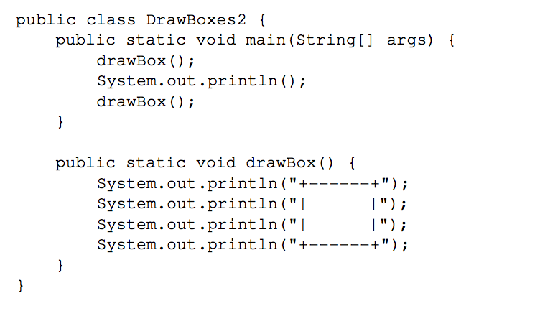
Flow of a Program

Slide 30
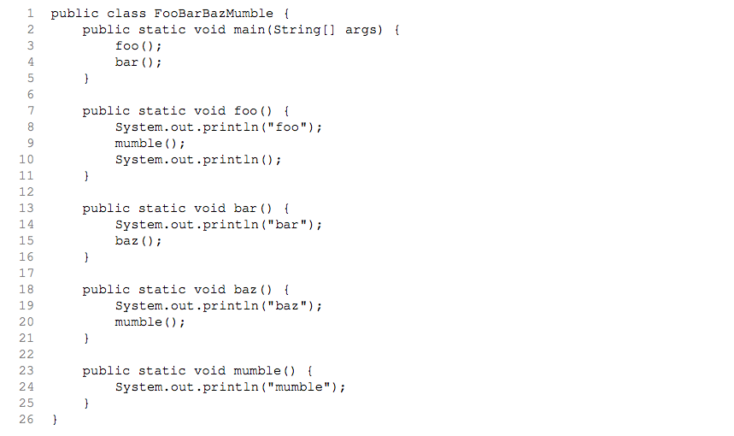
Flow of Program

Slide 31
Output
Output of FooBarBazMumble:
foo
mumble
bar
baz
mumble

Slide 32
Lab
Let {a1,a2,a3,…,an} be a list of n real numbers.
The average of the list denoted by ave = (a1+a2+…+an)/n.
The deviation of the entry ai from the average denoted by di = ai-ave.
The variance of the list =
[ (d1)^2 + (d2)^2 + … + (dn)^2 ] / n.
The standard deviation of the list = the square root of the variance of the list.

Slide 33
Lab
For example, if the list is {2,4,5,8,16}.
Average=7
d1=2-7=-5
d2=4-7=-3
d3=5-7=-2
d4=8-7=1
d5=16-7=9
Variance=[(-5)^2+(-3)^2+(-2)^2+1^2+9^2]/5=24
Standard deviation=square root of 24=4.898979486

Slide 34
Lab
Create three integer variables to store three test scores: test1, test2, test3.
Create an double variable to compute the average of the scores.
Create three double variables to compute the deviations.
Create two double variables to compute the variance and standard deviation.
Hint: To compute the square root of 9 for example, use Math.sqrt(9).

Slide 35
Lab
Your output should look something like:
The test scores are: 78, 82, 89.
The average of the scores is: 83.0
The variance is: 20.666666666666668
The standard deviation is: 4.546060565661952

